Slide 1


Stock market analysis
Understanding TRENDS
23-03-2023

Slide 2
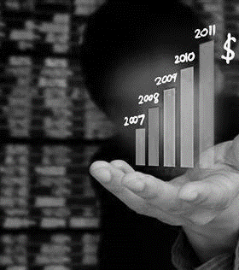
Business Objective
To identify purchasing and selling patterns by carefully analyzing the data to help the investors

Slide 3

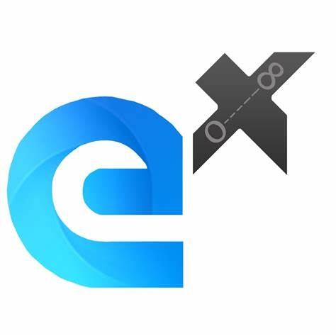
Agenda
INTRODUCTION
TEAM MEMBERS
EXPLORATORY DATA ANALYSIS
FEATURE ENGINEERING
MODEL BUILDING
MODEL DEPLOYMENT
CHALLENGES
CONCLUSION

Slide 4

INTRODUCTION
This project is about analysis of Stock Market using various software technologies like PYTHON,R etc.
The dataset used in this project is NIFTY-ENERGY.
We have done a trend analysis of the NIFTY listed energy related companies (RELIANCE,ADANIGREENS,ADANITRANS) and tried to show the pricing trends and patterns.

Slide 5








Meet the team
AISHWARYA RAUT
ERRI.APARNA
PRIYAJA NAYAK
SHASHIDHAR KAMBAR
ASHISH VIDHATE
SACHIN KV
HARSHAD DHOTRE
BARUN JENA

Slide 6
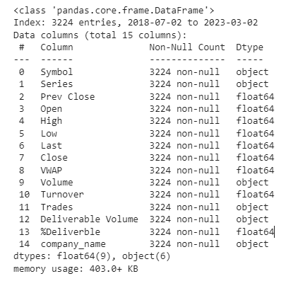
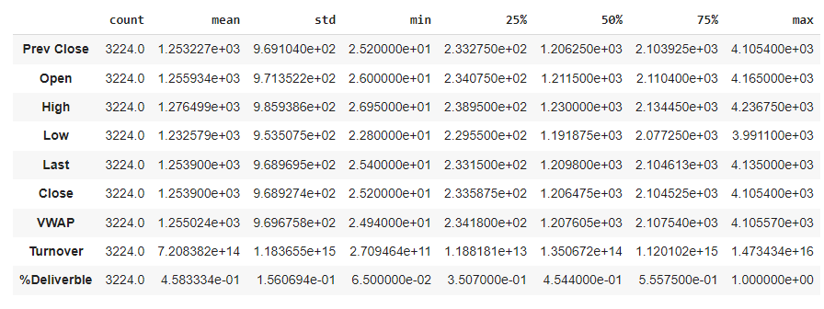
dataset Description
The data set has 15 columns and 3224 rows.
Contains data on 3 distinct stocks
(RELIANCE,ADANIGREENS,ADANITRANS)
12 relevant columns remain after the removal of 3 unnecessary columns.
The data set doesn't contain any duplicate or missing values.

Slide 7
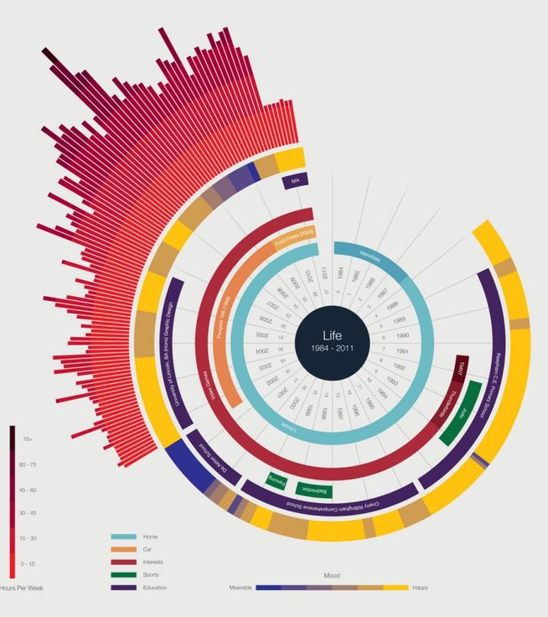
Exploratory DATA ANALYSIS
Analysis and Visualizations

Slide 8
FEATURE INFORMATION
Company : Name of NIFTY-ENERGY companies
Date : The date of the trading day.
Series : Type of stock (Equity)
Open : The opening trade price on Date.
High : The highest price at which the stock is traded on Date.
Low : The lowest price at which the stock is traded on Date.
Close : The last trade price on Date
Volume : The number of shares traded on Date.
VWAP : It's a trading benchmark that represents the average price a security has traded at throughout the day, based on both volume and price.
Turnover : Number of transactions per day.

Slide 9
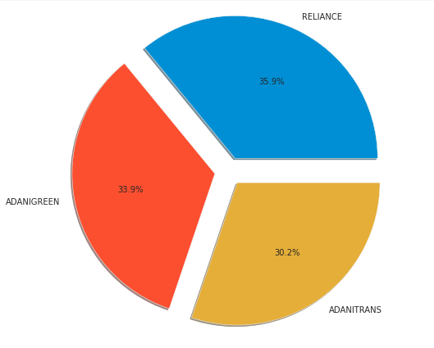
PROPORTION OF STOCK DATA
35.9% of the data belong to RELIANCE .
33.9% of the data belong to ADANIGREEN.
30.2% of the data belong to ADANITRANS.

Slide 10
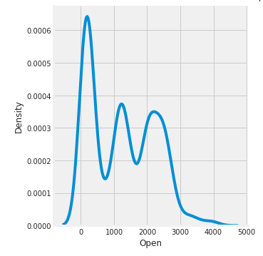
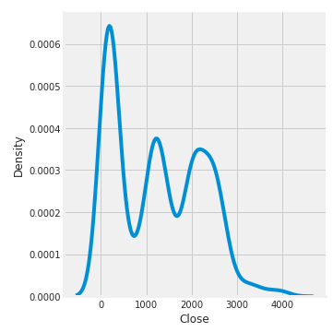
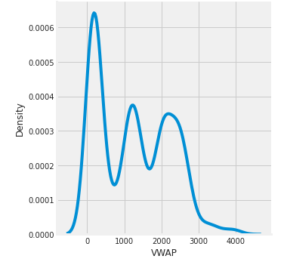
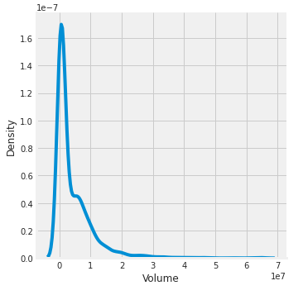
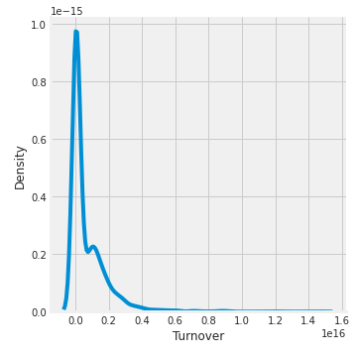
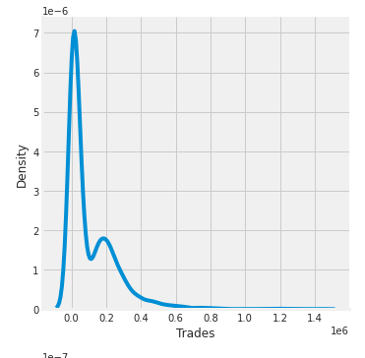
DISTRIBUTION PLOT OF VARIABLES
The data are right-skewed also called positively-skewed, according to the distribution plot.

Slide 11
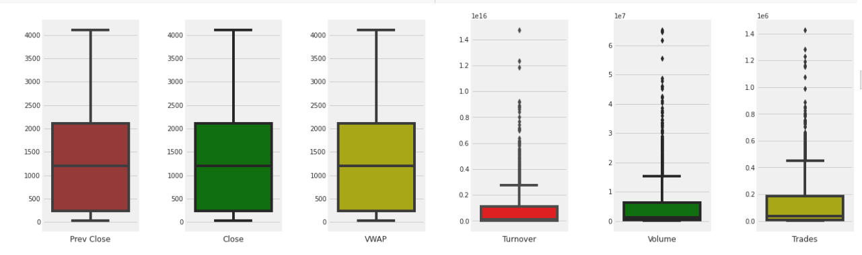
BOX PLOT FOR OUTLIER DETECTION
The Box plots shown above demonstrate that certain outliers exist in volume, Turnover and Trades features.

Slide 12
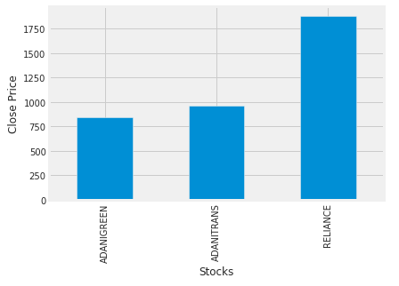
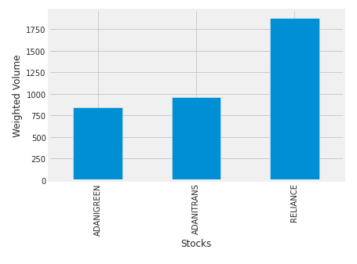
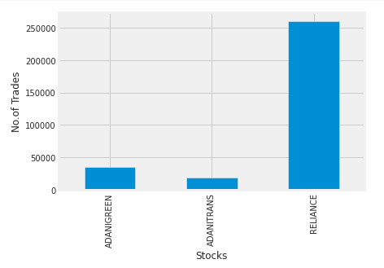
COMPARISION OF VARIOUS STOCKS
The bar graphs shown here demonstrate that over the time, the average closing price of Reliance has increased as a result of an increase in weighted volume and trader volume.
Despite having fewer dealers, ADANITRANS and ADANIGREEN have high closing prices.

Slide 13
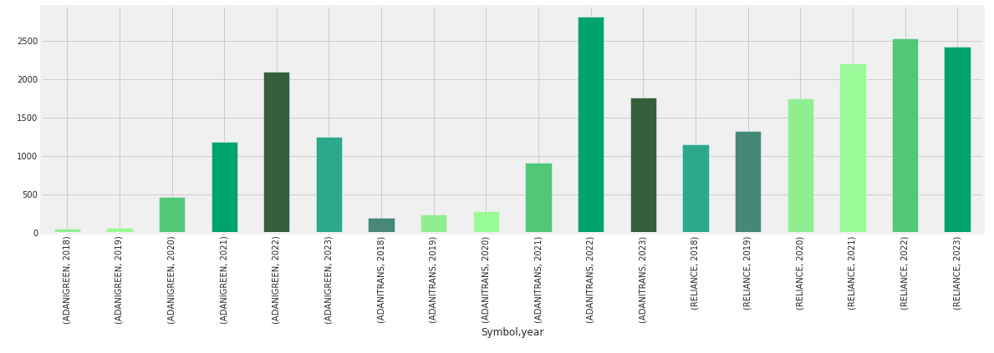
AVERAGE CLOSING PRICE PER YEAR FOR EACH COMPANY
In 2022, each stock's average closing price is high compared to the period.
The stock of ADANITRANS has the highest average closing price in 2022.
Reliance stock's closing price has been steadily rising throughout the time frame.

Slide 14
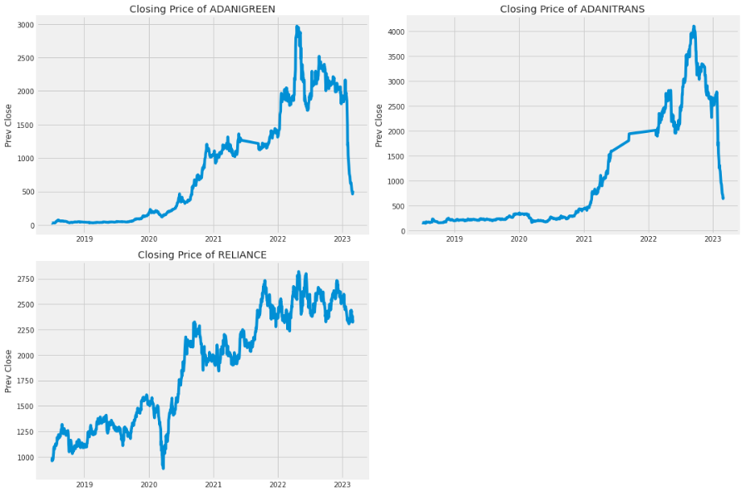
COMPARISION OF CLOSING PRICE OF STOCKS
RELIANCE displays an upward trend for stock closing prices, as shown by the trend line above.
ADANIGREEN and ADANITRANS are in an upswing, but by the middle of 2022, the closing price of the equities are in a downward trend.

Slide 15
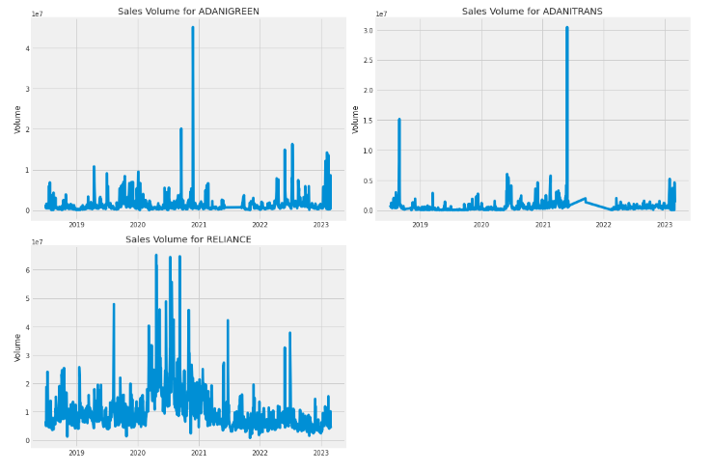
COMPARISION OF VOLUME STOCKS
The daily overall volume of trades of the Reliance stock is highest compared to other stocks.

Slide 16
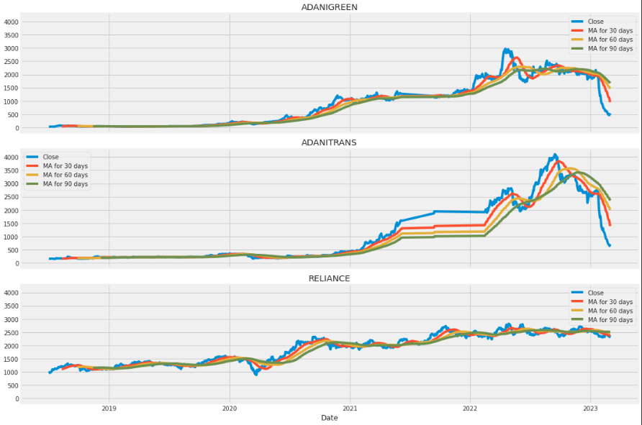
MOVING AVERAGE FOR 30 DAY, 60 DAY AND 90 DAY

Slide 17
MOVING AVERAGE FOR 30 DAY, 60 DAY AND 90 DAY
The moving average helps to level the price data over a specified period by creating a constantly updated average price.
ADANIGREENS and ADANITRANS moving average trends indicate an upward trend for closing prices.
The trend of the RELIANCE moving average is almost constant throughout time.
The 30 day moving average is the best to use because it accurately represents the trend without adding noise.

Slide 18
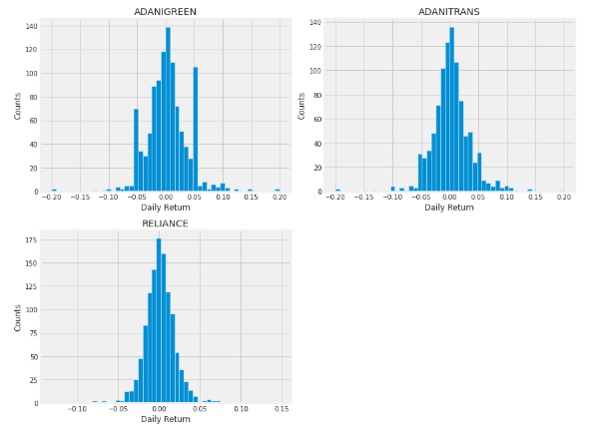
AVERAGE DAILY RETURN OF STOCKS
The number of daily returns for Reliance is higher than that of other stocks, indicating that traders are more active in Reliance's stock than in other stocks.

Slide 19
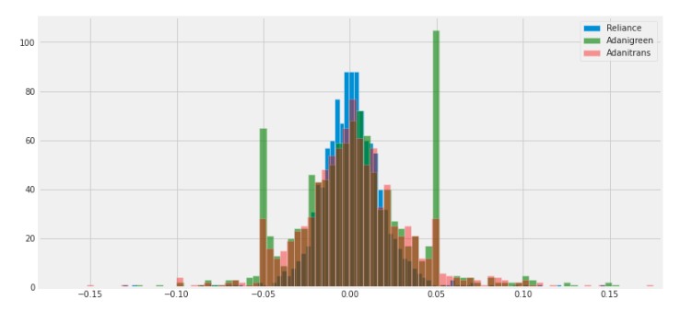
VOLATILE STOCK
It is clear from the histogram that the percentage increase in stock price for ADANIGREEN is the widest which indicates the stock of ADANIGREEN is the most volatile among the three companies compared.

Slide 20
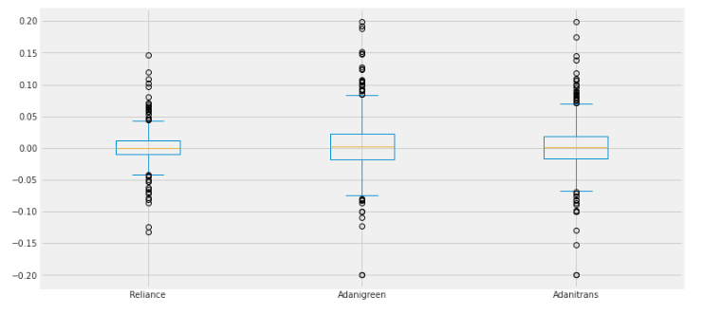
BOX PLOT FOR DAILY RETURN
The box plot shown above demonstrates that there are outliers in the daily returns for each company.

Slide 21
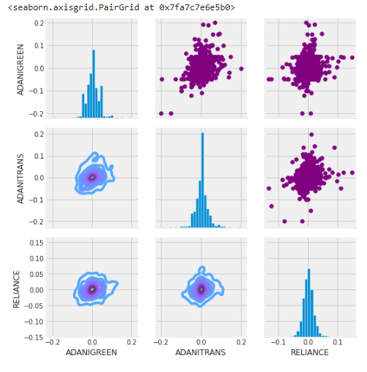
PAIRPLOT FOR STOCKS CLOSING PRICE
According to the pairplot shown above, there is no linear correlation between the daily returns of RELIANCE, ADANIGREEN, and ADANITRANS.

Slide 22
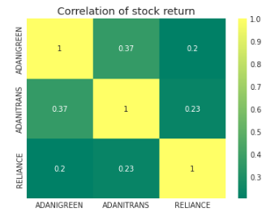
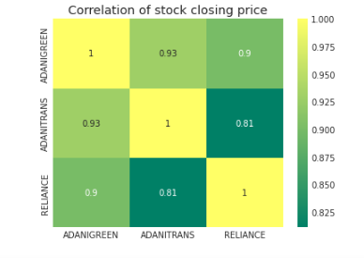
HEATMAP FOR DAILY RETURN AND CLOSING PRICE
According to the heatmap, there is a weakly positive correlation between the daily returns of three stocks.
The heatmap, on the other hand, reveals that the closing prices of three stocks have a close to perfect correlation.

Slide 23
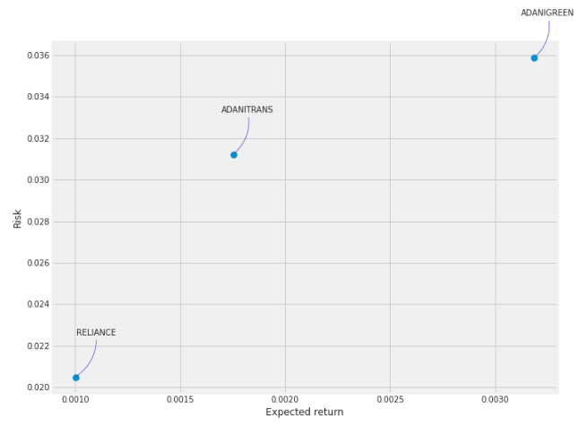
RISK QUANTIFICATION PLOT
The graph's risk quantification reveals that the daily returns of ADANIGREEN carry the greatest risk, followed by ADANITRANS.
RELIANCE stock offers a lower daily return at lower risk.

Slide 24
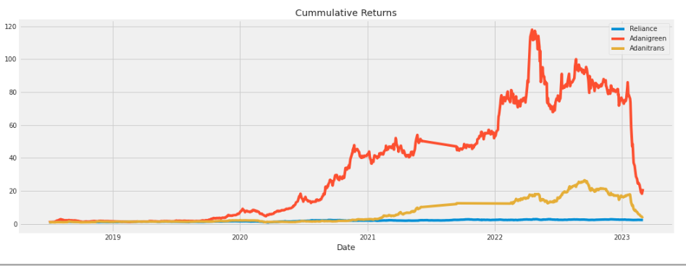
CUMULATIVE RETURN OF STOCKS
The trend line above demonstrates that ADANIGREEN has the highest cumulative returns, followed by ADANITRANS.
RELIANCE stock's total returns are nearly equal to your investment.

Slide 25
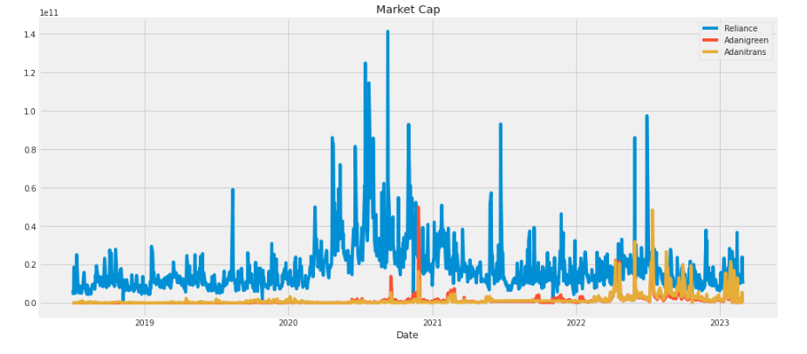
MARKET CAPITALIZATION OF STOCKS
The market capitalization of Reliance stock is highest compared to other equities, as can be seen from the aforementioned trend.

Slide 26
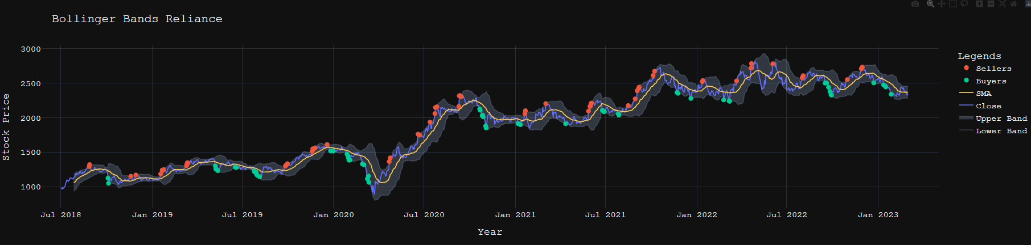
BOLLINGER BAND PLOT FOR RELIANCE STOCK
The Bollinger Band diagram shown above indicates that the RELIANCE'S stocks are frequently bought or sold. Hence, it demonstrates that RELIANCE stocks have the most active traders.

Slide 27
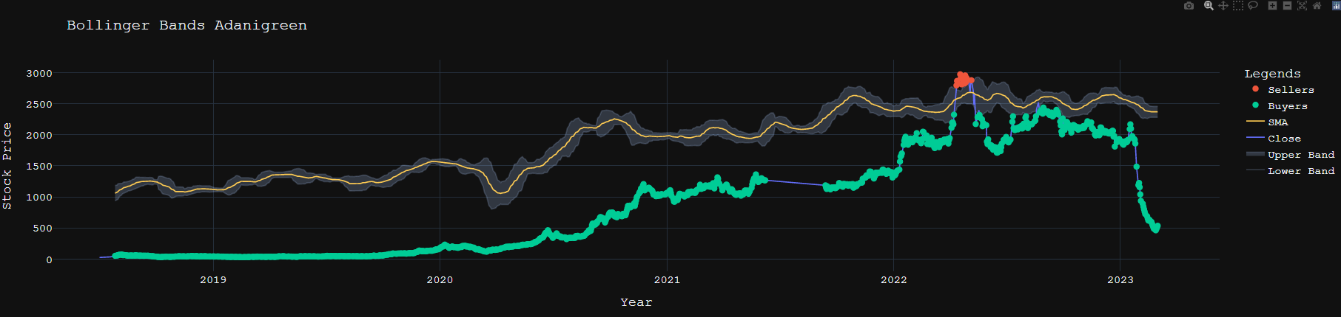
BOLLINGER BAND PLOT FOR ADANIGREEN STOCK
According to the Bollinger Band plot shown above ADANIGREEN stocks are more frequently bought than sold throughout the time period,. Furthermore, it demonstrates that traders view ADANIGREEN stock as a profitable stock.

Slide 28
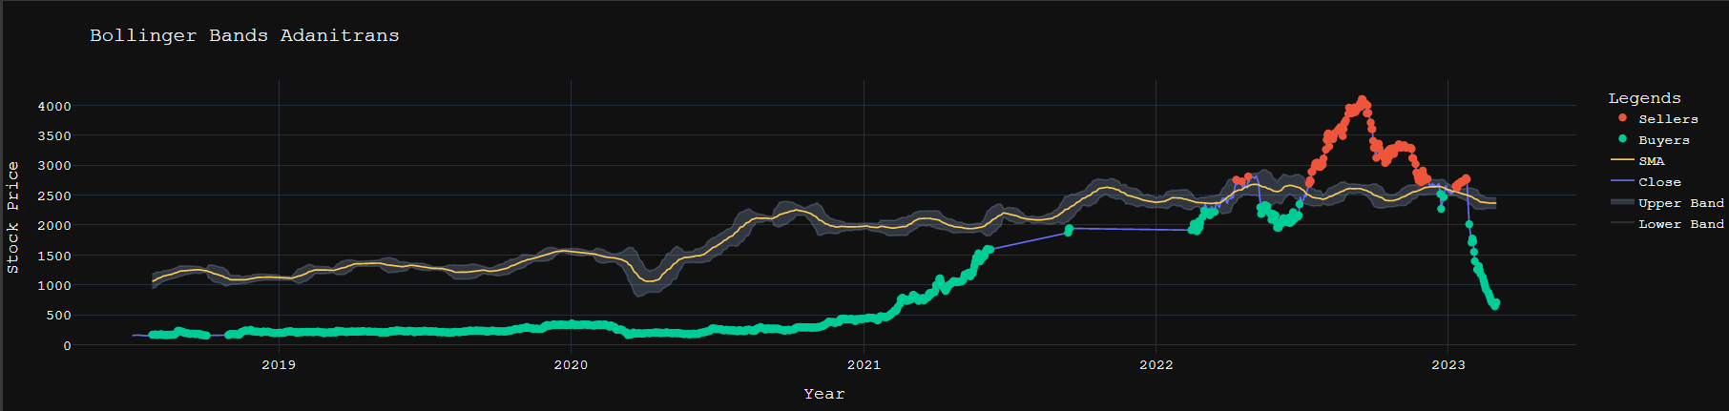
BOLLINGER BAND PLOT FOR ADANITRANS STOCK
The ADANITRANS stocks are more likely to be bought than sold throughout the specified time period, according to the Bollinger Band plot above. Nonetheless, traders have sold more ADANITRANS shares recently than they have bought.

Slide 29

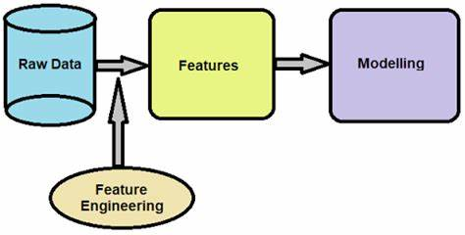

Slide 30
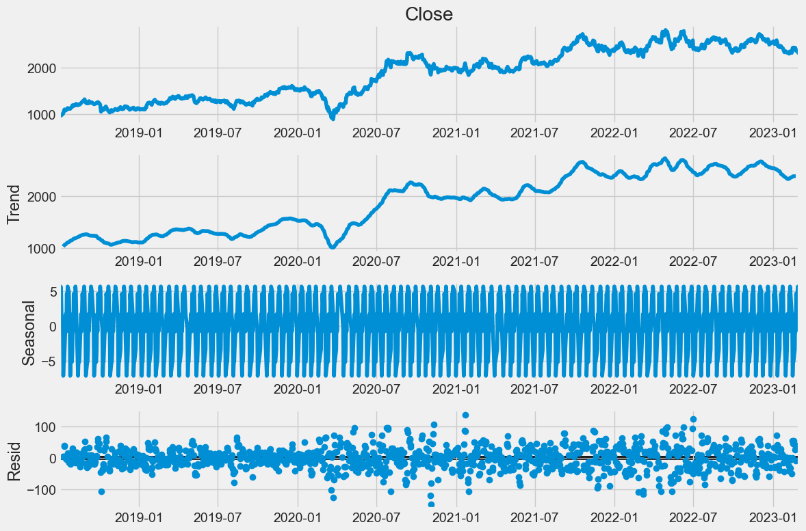
Characteristics of time series data
We have transformed the data into log form to deal with outliers.
Trend and seasonal components can be seen in the data in the decomposition plot below.

Slide 31
To Check stationary(Manually)
We have used the Augmented Dickey-Fuller (ADF) test to verify the data's stationarity.
Null Hypothesis (H0): The time series has a unit root and is non-stationary.
Alternative Hypothesis (H1): The time series does not have a unit root and is stationary.
If p-value obtained from the ADF test is less than significance level (i.e. 0.05), we reject null hypothesis and conclude that the time series is stationary.
Conversely, if p-value is greater than the significance level, we fail to reject the null hypothesis and conclude that the time series is non-stationary.

Slide 32
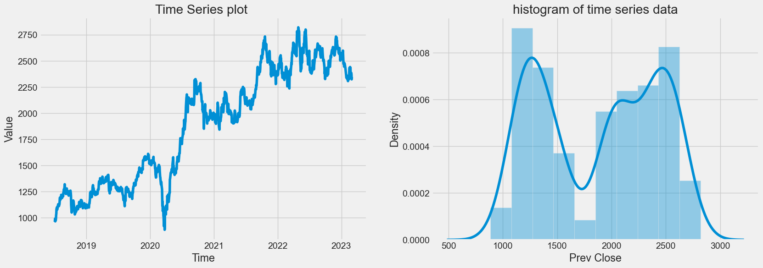
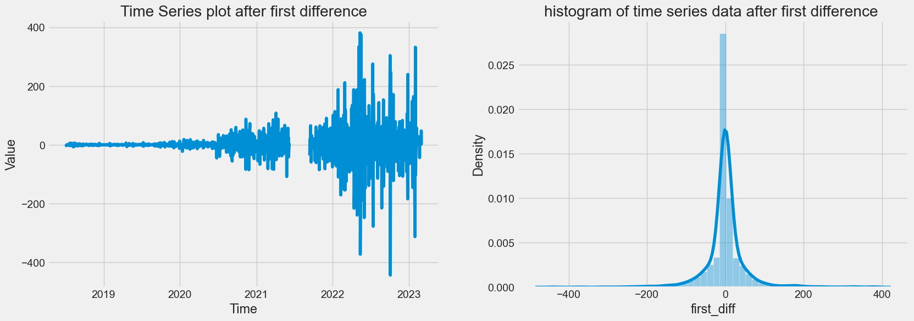
CONVERTING NON-stationary TO STATIONARY
To deal with the non stationary data, we use Differencing method.
Differencing is a common method is used in time series analysis to transform a non-stationary time series into a stationary one by taking the difference between consecutive observations.
Before difference
mean1 = 1421.567388 ,mean2 = 2340.654922
var1 = 109707.631339 ,var2 = 62096.945049
After first difference
mean1 = 0.007626 ,mean2 = 0.041732
var1 = 90.853779 ,var2 = 6674.781827

Slide 33
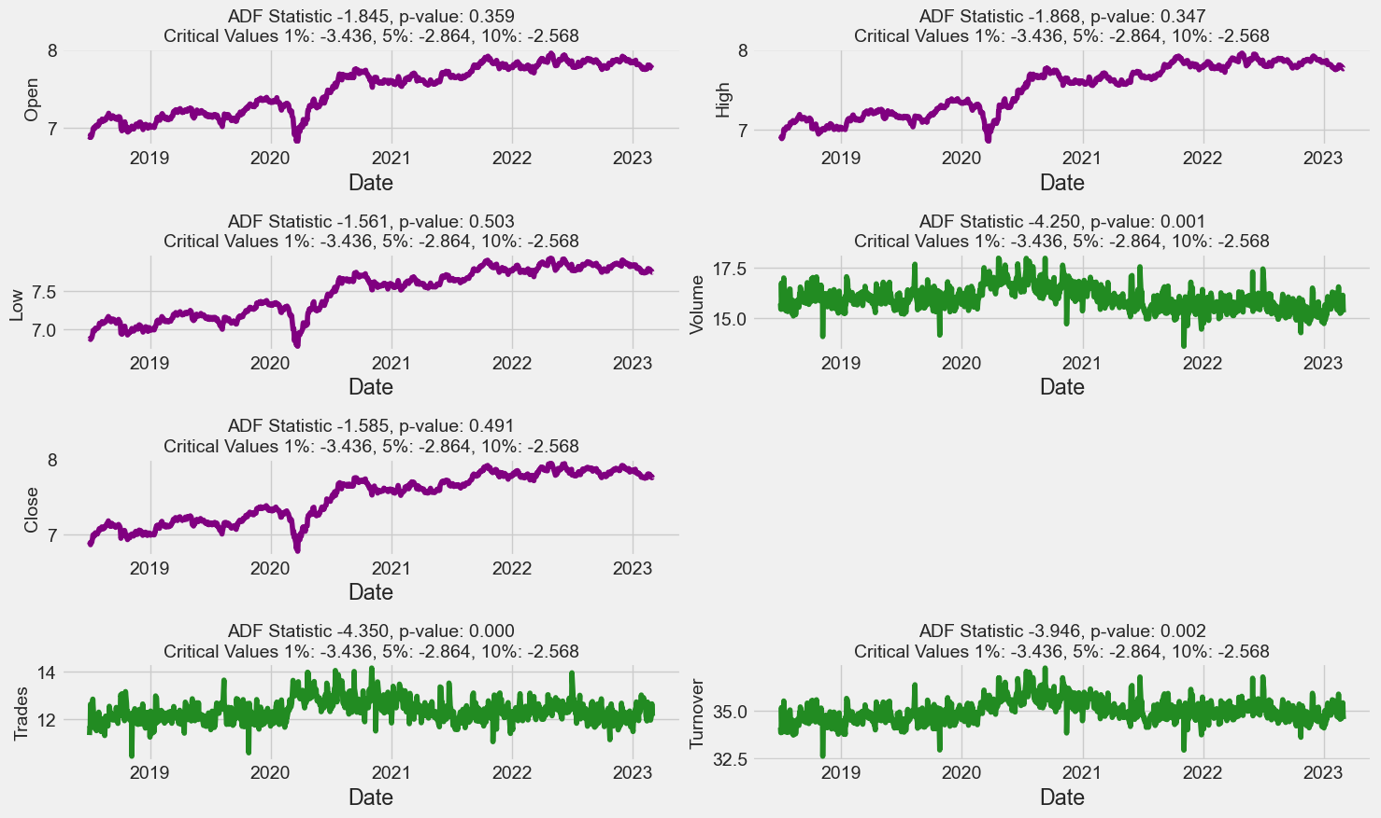
ADF(Augmented Dickey Fuller test) for reliance
Here, the purple-colored graph has a p-value greater than 0.05, indicating that the features are not stationary by nature.
The graphs in green, on the other hand, have a p-value that is less than 0.05, indicating that the features are stationary in nature.

Slide 34
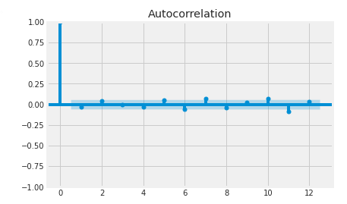
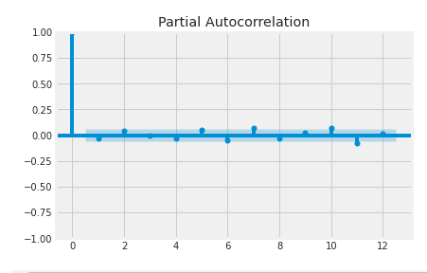
ACF and PACF PLOT
The blue shaded region in the ACF and PACF plot represents the 95% confidence interval, within which the autocorrelation coefficients are expected to fall.
In our ACF plot, the coefficient at lag 5,6,7,11 has statistically significance, that have positive correlation. Hence the value of q is 3.
In our PACF plot, we can see that lag at 7,10,11 has statistically significance. Hence value of q is 2.

Slide 35
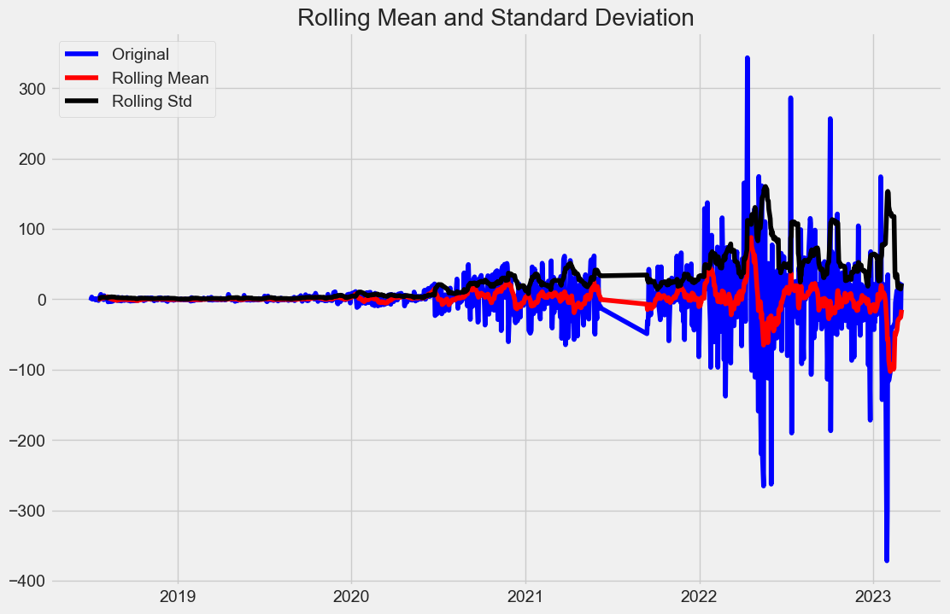
Moving Average plot of stationary data
The above plot shows that the mean and standard deviation of time series data is almost constant over the time.

Slide 36
Train – test split
Time series train-test split must consider the temporal order of data, resulting in a training set of shape and a testing set of shape.
We have consider 80-20 rule for data splitting. 80% data for training the model and 20% of data for testing the model.
To create a model for the RELIANCE Stock, training and testing data have the following shapes: (925,) (232,) correspondingly.
The training and testing sets of data used to create a model for ADANIGREEN Stock are in the shapes of (873,) (219,) correspondingly.
Building a model for the ADANITRANS Stock requires training and testing sets of data that are, respectively, in the shapes of (777,) (195,).

Slide 37

MODEL BUILDING

Slide 38
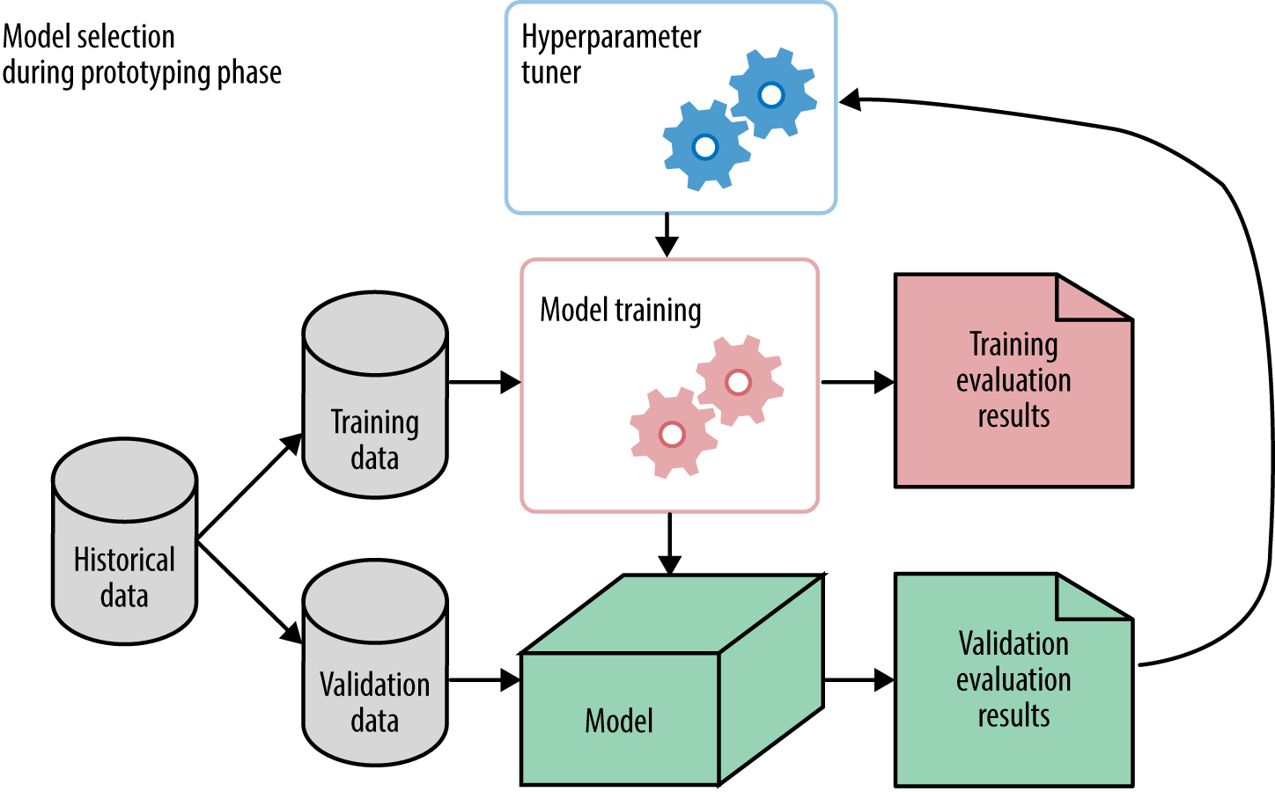

Slide 39
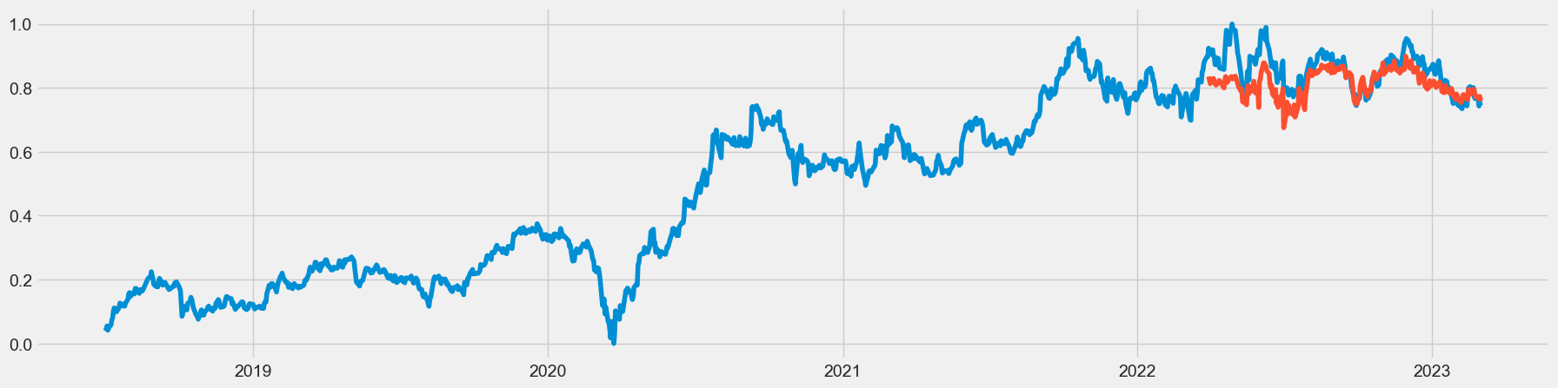
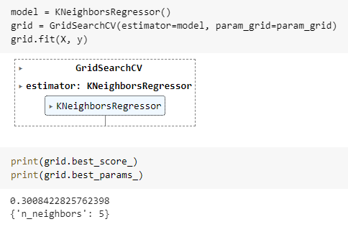
K-Nearest neighbor
Firstly, we implement the simple technique of the KNN model, which uses the neighbors to predict stock prices.
Using GridSearchCV, we were able to determine the appropriate number of K, and the optimum value was 5.
For the reliance stock, we obtained a 77% model accuracy.

Slide 40
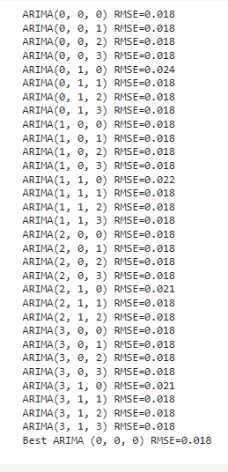
Model building: Arima
ARIMA (Autoregressive Integrated Moving Average) is a commonly used time series model that combines three components to capture trends and patterns in data:
1. Autoregression (AR): incorporates the dependence of the current value on past values through a linear equation.
2.Integration (I): uses differencing to remove trends and make the time series stationary.
3.Moving Average (MA): incorporates the dependence of the current value on past errors through a linear equation.
ARIMA models are typically denoted as ARIMA(p, d, q), where p is the order of the autoregressive term, d is the degree of differencing, and q is the order of the moving average term.
In order to select the value with the least amount of error, we have used numerous combinations of p, q, and d values.
For RELIANCE stock, the RMSE score for the optimal ARIMA order (0, 0, 0) was 0.018.
For ADANIGREEN stock, the RMSE score for optimal ARIMA order (0,0,0) was 0.0434.
For ADANITRANS stock, the RMSE score for optimal ARIMA order (1,0,0) was 0.0399

Slide 41
Model building: Fbprophet
The model is based on decomposing the time series into three main components: trend, seasonality and residual.
The trend component represents the underlying pattern of the time series, while the seasonality component captures the periodic changes in the data, such as daily, weekly, or monthly fluctuations.
We utilize daily seasonality and a multiplicative model for seasonality in the FBPROPHET model.
The FBPROPHET model predicts RELIANCE stock with an accuracy of 86%.
The FBPROPHET model predicts the pricing of ADANIGREEN with 93% accuracy.
The FBPROPHET model has 96% accuracy for ADANITRANS stock.

Slide 42
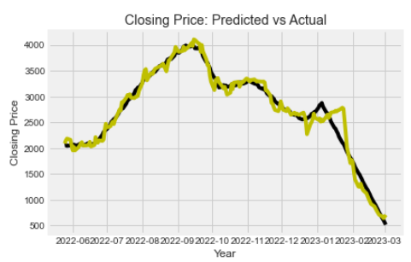
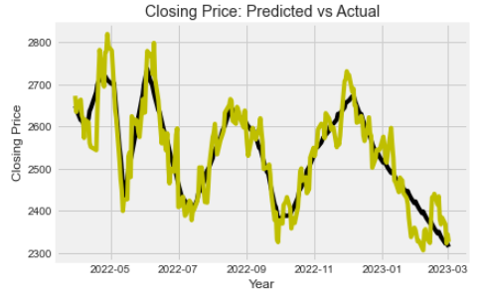
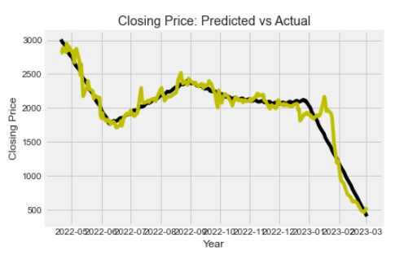
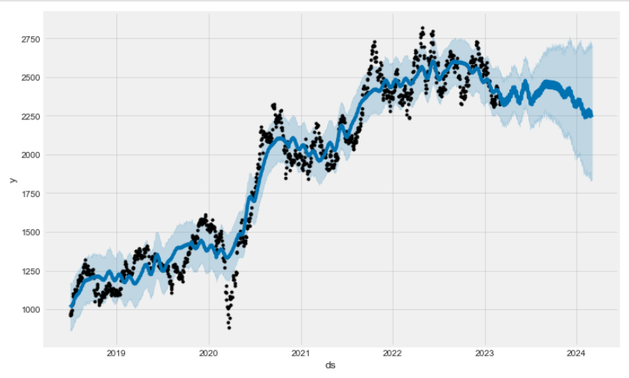
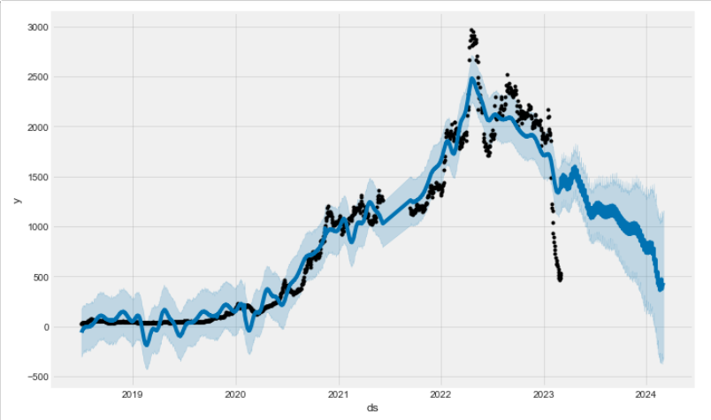
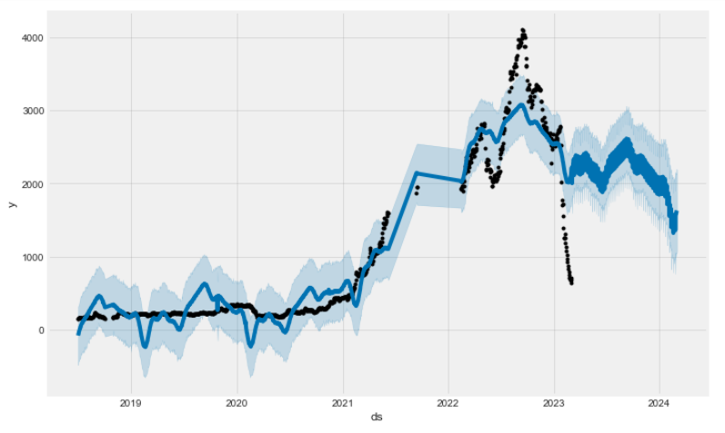
Arima fbProphet
RELIANCE
ADANIGREEN
ADANITRANS

Slide 43
LSTM(Long-short term memory)
Long Short-Term Memory (LSTM) is a type of recurrent neural network (RNN) that is commonly used for time-series prediction tasks, including stock market prediction. LSTM networks are particularly useful for these tasks because they are able to retain information over long periods of time and can learn to recognize patterns in the data.
Using both the Adam optimizer and the RELU activation function, we developed an LSTM model for the prediction of Reliance Stock. We obtained an RMSE value of 0.0469 using the LSTM model.
We created an LSTM model for predicting the price of ADANIGREEN using both the RMSProp optimizer and the linear activation function. The RMSE value we obtained using the LSTM model is 0.0497.
The linear activation function and Adam optimizer functions were used in the LSTM model we created for the prediction of ADANITRANS stock. The RMSE value derived was 0.0608.

Slide 44



LSTM(Long-short term memory)
Reliance
ADANIGREEN
ADANITRANS

Slide 45
MODEL BUILDING Inference
For the stocks of RELIANCE, ADANIGREEN, and ADANITRANS, we tested several models to estimate the stock market closing price. We then showed the KNN, ARIMA, FBPROPHET, and LSTM models.
The model with the highest accuracy and lowest RMSE values out of all the models we tried is the FBPROPHET model, which is followed by the LSTM model.

Slide 46

Mo del Deployment

Slide 47




Forecasting future codes
.

Slide 48

Forecasting using streamlit
Enter the company name and number of days to be forecast and click on the predict.

Slide 49



model deployment visualization
The above graph included daily, weekly, and monthly trading.

Slide 50
Challenges
While trying multiple models, many models showed minimal accuracy which we had to discard.
The accuracy and RSME values changed as the system changed.
Use of new models in the project which required deeper understanding posed a challenge for model building.
The code was too long, every time we have to run the libraries again and again which wasted a lot of time.
Availability of team members on schedule due to different engagements.
Understanding and thought process of team members was different so it was difficult to come into a consensus.

Slide 51

conclusion
CONCLUSION
Reliance has more traders than other equities, therefore its closing price rises over time. Market capitalization has grown for Reliance over the period. With less risk, Reliance offers high daily returns. The cumulative return on dependence has decreased to lower the returns, but it still equals to your initial investment. Investors are more prone to often buy and sell dependence stocks.
ADANITRANS' closing price rises over time even when there are fewer dealers. In terms of market capitalization, ADANITRANS is second to RELIANCE. ADANITRANS' daily return is higher than Reliance's, but lower than ADANIGREENS'. Recently, traders have begun to sell equities here.

Slide 52
conclusion
CONCLUSION
ADANIGREEN'S closing price has risen over time even though there have been fewer traders. ADANIGREEN'S stocks have higher volatility than other equities do. ADANIGREEN is a stock with a little market capitalization yet a large daily return and risk. As ADANIGREEN'S cumulative return is the highest in comparison to other stocks, investors are more willing to purchase its stocks.

Slide 53


